Slide 1

University library books
Presented by Maha Mohammed
ID: 202002565
section: 2
May 28, 2022

Slide 2

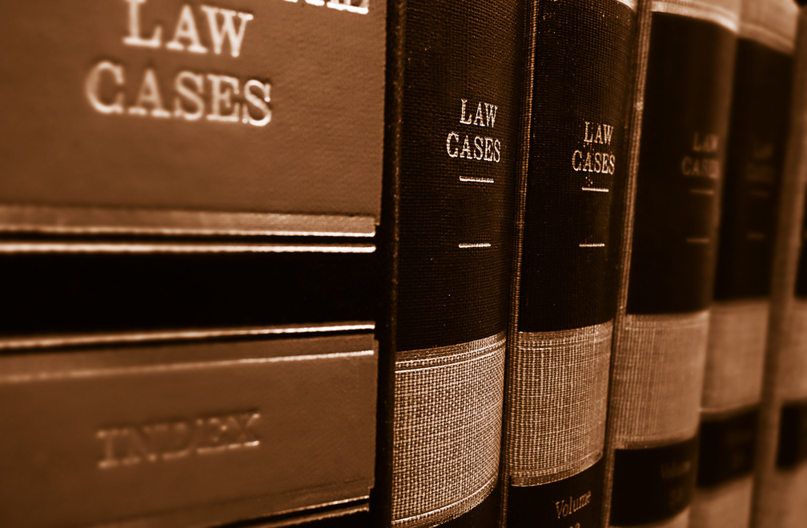

Objectives of the system:
May 28, 2022
This system will help students and academic staff to access the books they need or resources that can benefit them in their specialization. A large and diverse library of these books will be provided to them, and the books will be divided according to the type of specialization to help students expand their field by providing books related to the field and taking A simple overview of other disciplines and also the provision of some books that help students in life after university.
Page 02 0f 10

Slide 3


University library books :
A library management system is software that controls all aspects of a library's operations. It assists librarians in keeping track of new books and books borrowed by members, as well as their due dates.
All your library's activities are totally automated using this system. The best approach to keeping track of, organizing, and managing many volumes is to use library management software.
To keep track of library records, a library management system is utilized. It keeps track of the number of books in the library, how many are issued, how many are returned or renewed, and late fine costs, among other things.
short description

Slide 4
User identification:
Every student or doctor in the university is allowed to create an account through his university email, then he can log in to the system at any time by email or username, on more than one device at the same time.
Short Description for my Component:

Slide 5
Use cases:
Register: Every student or doctor in the university is allowed to create an account through his university email.
Login: The user can log in to his account at any time and on more than one device at the same time.
Delete account: The user can permanently delete the account from the system or from his device at any time he wants.
Validation user: Functionality that when the user either student or doctor to enter password the system will verification the password.
Change password: the user can change the account password at any time he wants.

Slide 6
Scenarios:
Use case 1: Register
Primary Actor: User
Pre-condition: user must be a student or a doctor at the university and not to be registered with the same email previously
Postcondition: user can login with his account
Quality requirement: the system should protect user’s personal information, Security first when it comes to user data
Priority level: High level
Related functional requirement IDs: UND-X4C-I
Main Scenario:
1- User presses the Create account button
2-System asks the user to enter his first name, last name, university email, username, password, confirm password, and phone number
3-System asks user to choose appropriate verification method by email or phone number.
4-User choose verification by email.
5-User enters his email
6-System will be sent ae email to verify of the email registered.
7- Verification successfully
8- Register verification.
Alternate Scenario:
5(a). A personal, non-university email.
5(a)1. Ask user to enter valid email.

Slide 7
Scenarios:
Use case 2: login
Primary Actor: User
Precondition: the account that the user is logging in with must be exist.
Postcondition: User can do his activity (buy/sell/return/add/reserve books)
Quality requirement: the main page should load in less than 2 seconds when the user enters valid email and password and the user must be able to login into his account within a time period of fewer than 2 seconds if it’s considered more than that then we have a problem.
Priority level: High level
Related functional requirement IDs: GDC-BDW-WE2
Main Scenario:
1-User wants to login application
2-System asks the user to choose the appropriate login method for him by email, username, or phone number
3-User choose by email
4-User enters his email and password.
5-Login button appeared.
6-User presses the login button.
7- System verifies the validity of user information.
8- User information validation and login successfully.
Alternate Scenario:
7(a). invalid email or password
7(a)1. Notify the user that there is wrong information and allow him to enter it again.

Slide 8
Scenarios:
Use case 3: Delete account
Primary Actor: User
Pre-condition: the account to be deleted must be exist
Postcondition: user receive confirmation that his account had been deleted.
Quality requirement: The user must be able to delete his account and the account must disappear from the main database and his device. The account must be saved to another database called Deleted Accounts to help the users to retrieves their account within a period of time not exceeding 30 days.
Priority level: medium level
Related functional requirement IDs: GXR-BDE-BRE
Main Scenario:
1- User tries to enter by typing the academic number and password.
2- Go to settings after logging in to the account successfully.
3- Choose the option to delete the account.
4- Confirms the process of deleting the account by entering the password for his account
5- The account is deleted successfully.
Alternate Scenario:
1.(a)forgot the password
(a)1. send an email to the office to change the password.

Slide 9
Scenarios:
Use Case 4: validation user
Primary Actor: User
Pre-Condition: The user must have an account in the application and is logged in to it
Postcondition: User Verified
Quality requirement: The verification time for user ID and related information must be done in less than 1 second in order to provide accessibility to our software program.
Priority level: High level
Related functional requirement IDs: GDC-BDW-WE2
Main Scenario:
1-User tries to log in by typing the academic number and password
2-User forgot the password to log in to library system application.
3-After trying to log in for several times, the change password button appeared.
4-To change the password, he will be sent a code to verify the user on the number registered at the university.
5-Password changed and user validation
Alternate Scenario:
4(a). It can only start facial verification

Slide 10
Scenarios:
Use case 5: Change password
Primary Actor: User
Precondition: the user must enter the old password for the account
Postcondition: Password has been changed.
Quality requirement: When users use this functionality the data of new password information must be saved into the main database related to the passwords of users. This function must be done immediately and sign out from any device until he enters the new password. To provide security to our software program.
Priority level: medium level
Related functional requirement IDs: GDC-BDW-WE2 , GXR-BDE-BRE
Main Scenario:
1-User want to change his password with a stronger one
2-User go to account settings
3-User presses change password
4-System asks the user to enter his old password.
5-User enter his old one.
6-System asks user to enter new password and confirm it
7-User enters the new password and confirm it
8-Change password successfully.
9-System sent informing email to the user
Alternate Scenario:
5(a). User enters wrong old password
5(a).1 System asks user to re-enter the password

Slide 11
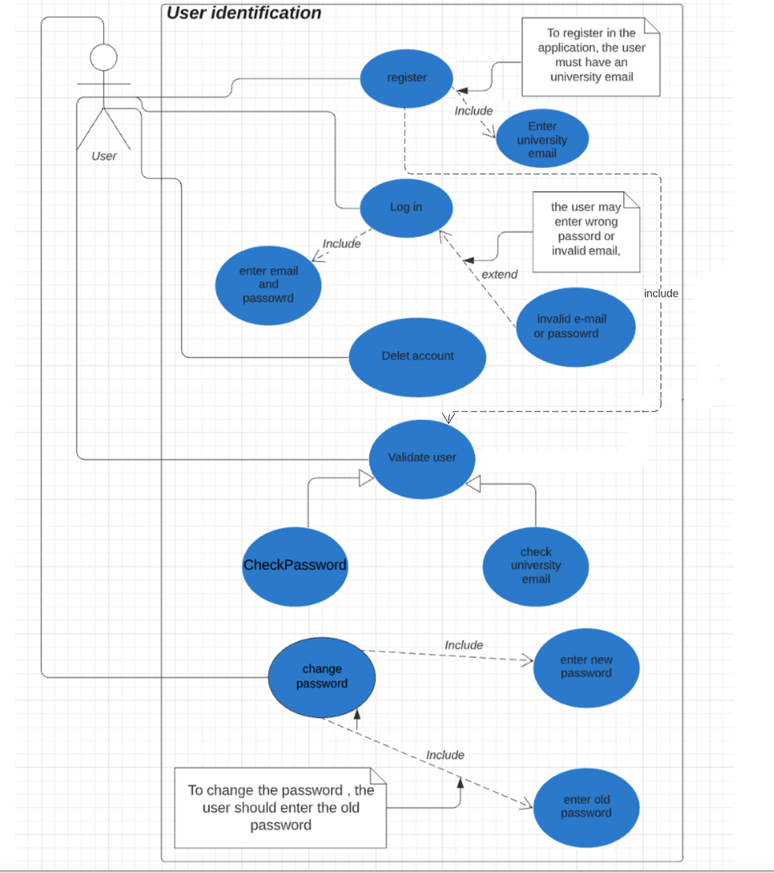
UML Use Case Diagram of User identification:

Slide 12
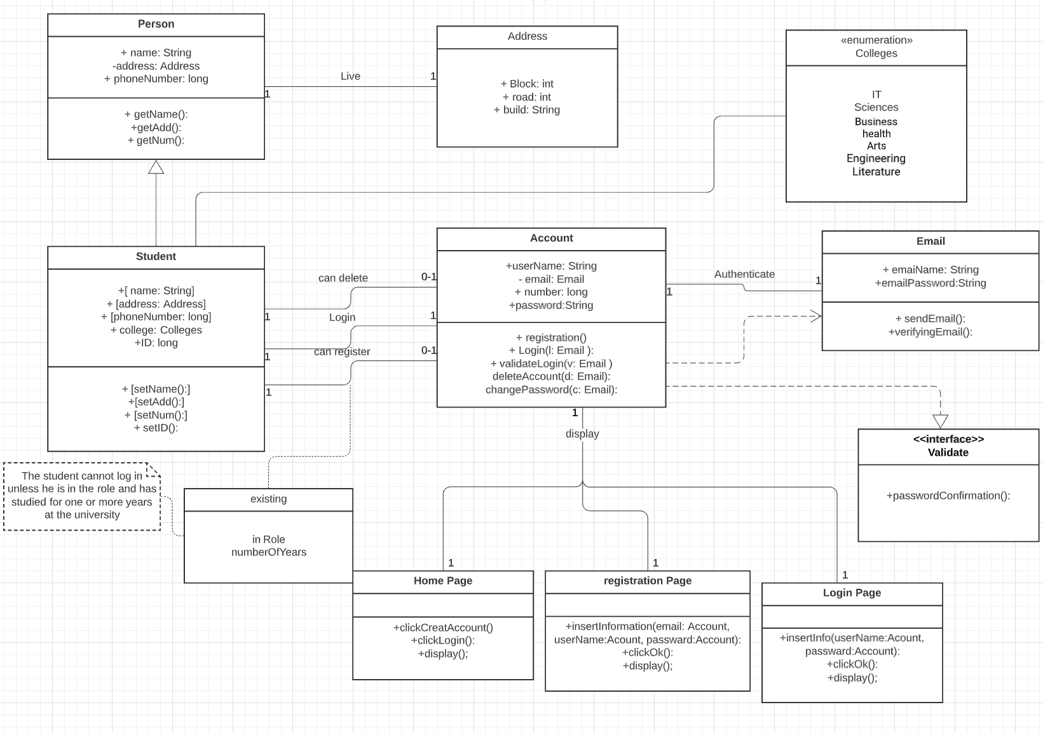
UML Class Diagram of User identification:

Slide 13
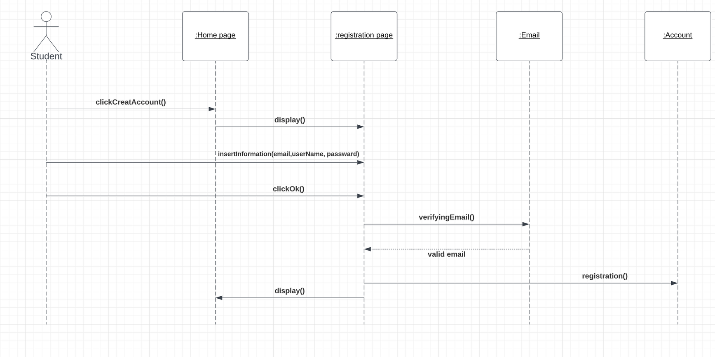
Registration use case:
UML sequence diagram(dynamic behavior)
of User identification:

Slide 14
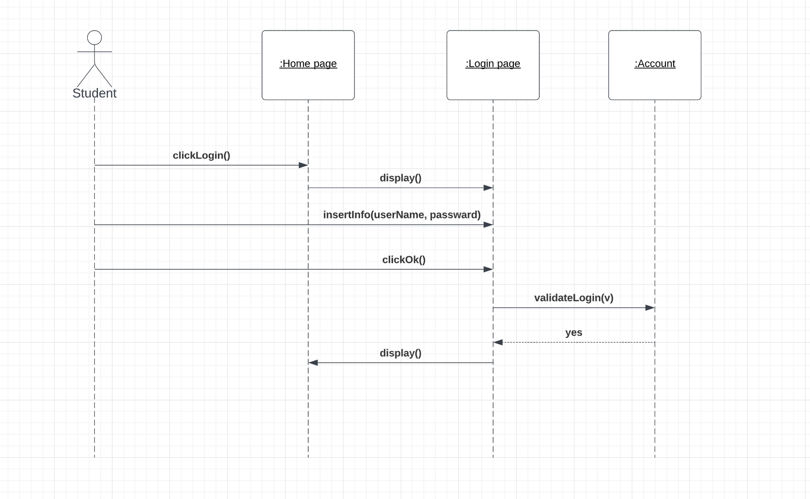
login use case:
UML sequence diagram(dynamic behavior)
of User identification:

Slide 15
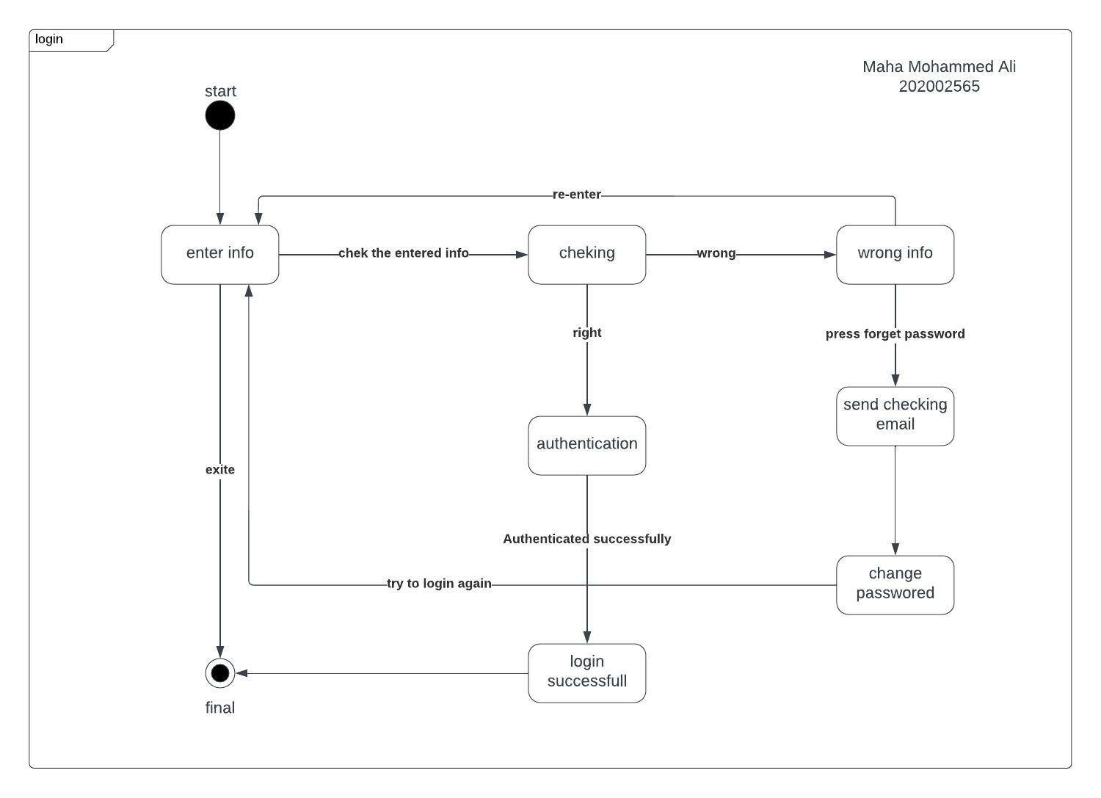
state diagram of User identification:

Slide 16
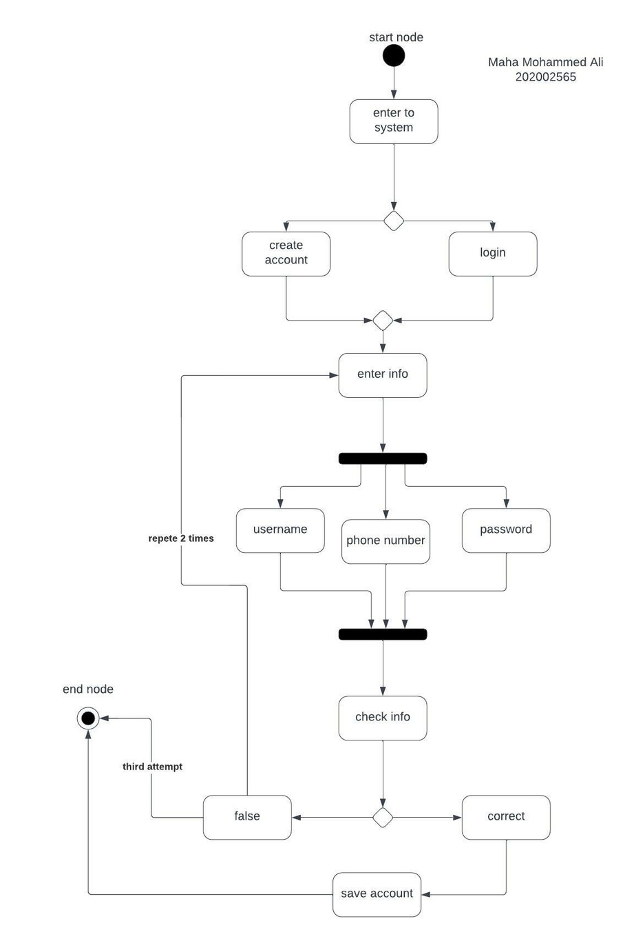
activity diagram
of User identification:

Slide 17
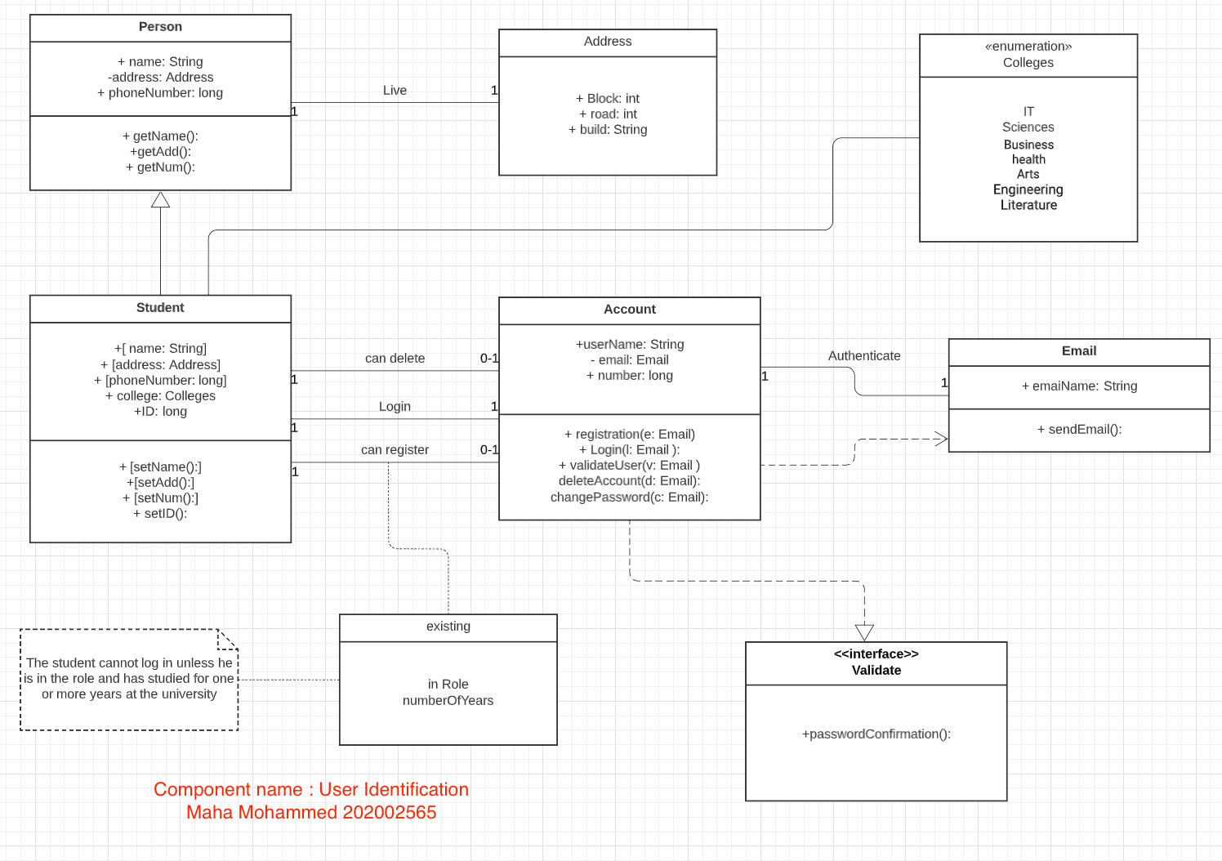
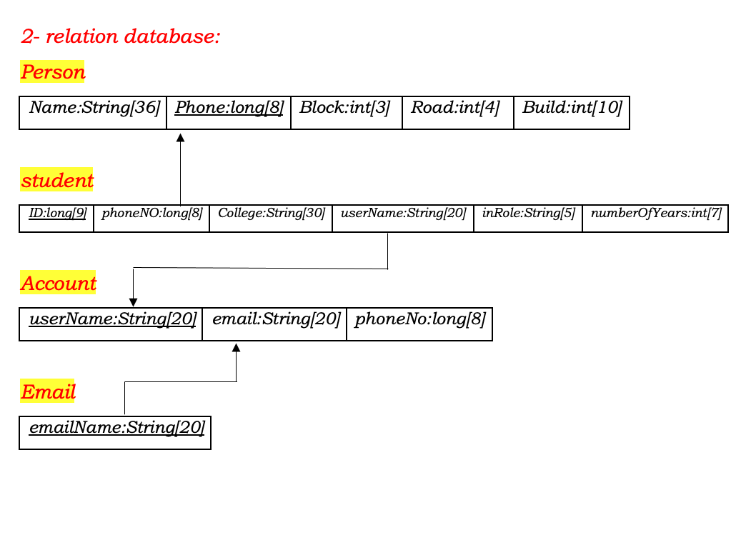
Database relation schema: note: The quiz was done based on the old UML class diagram

Slide 18
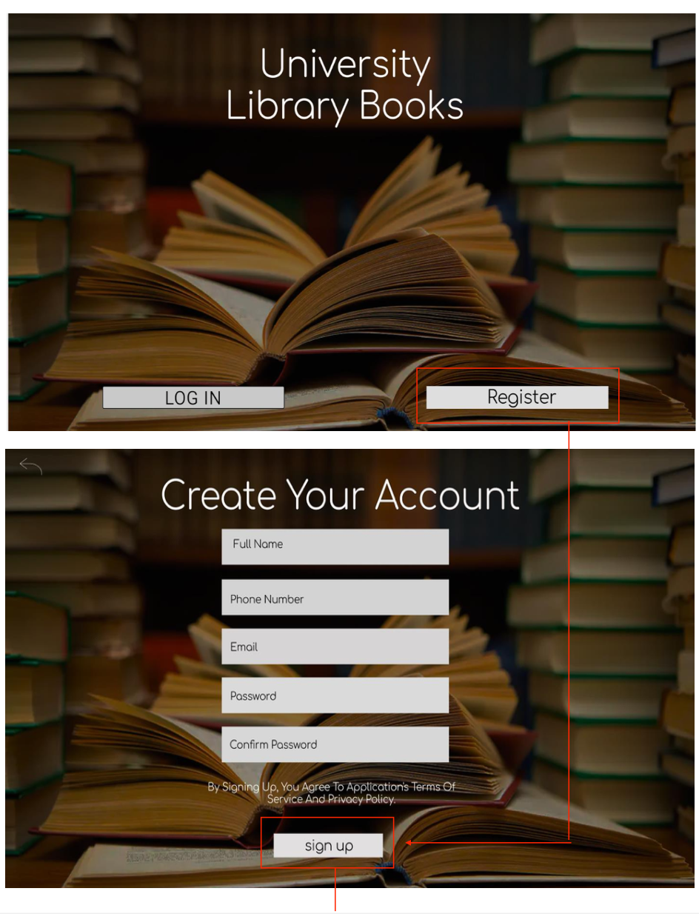
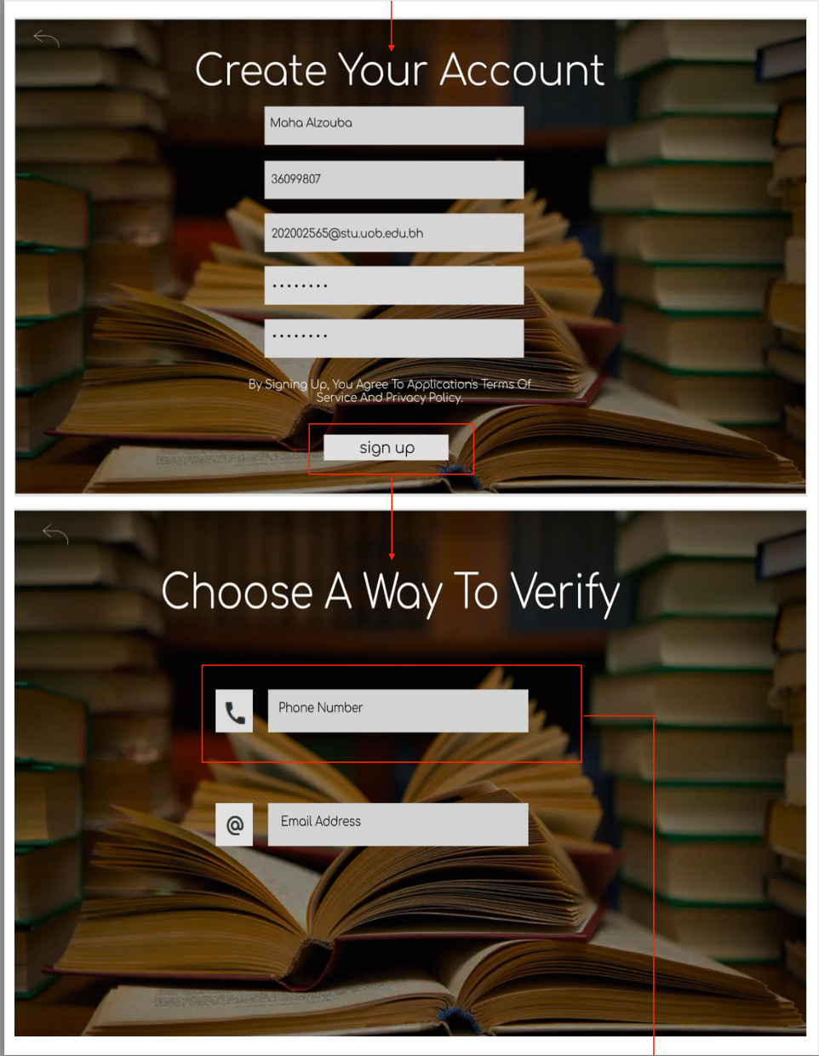
GUI Prototype

Slide 19
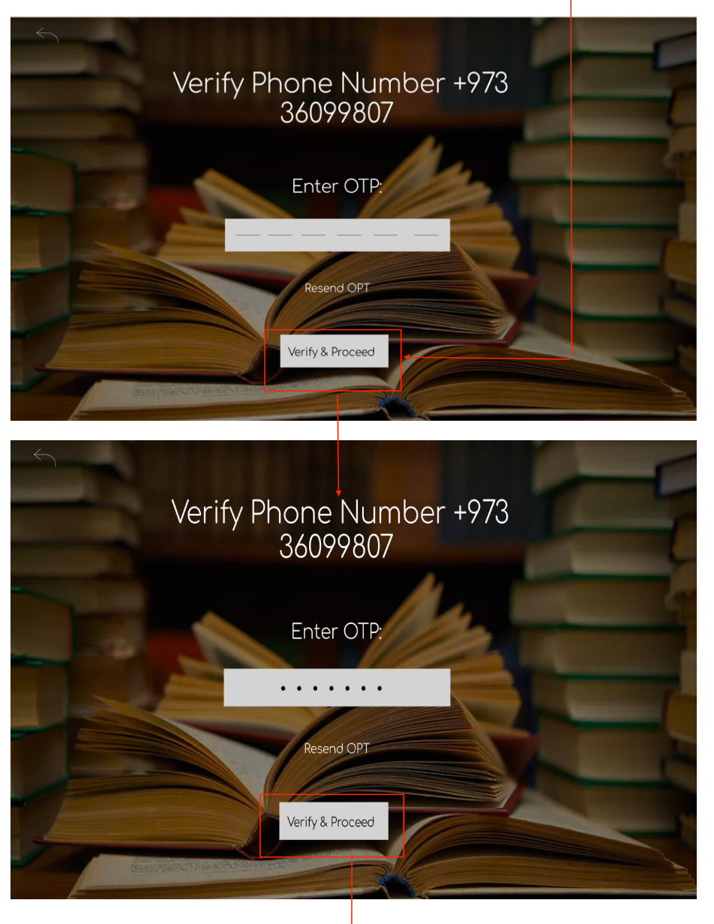
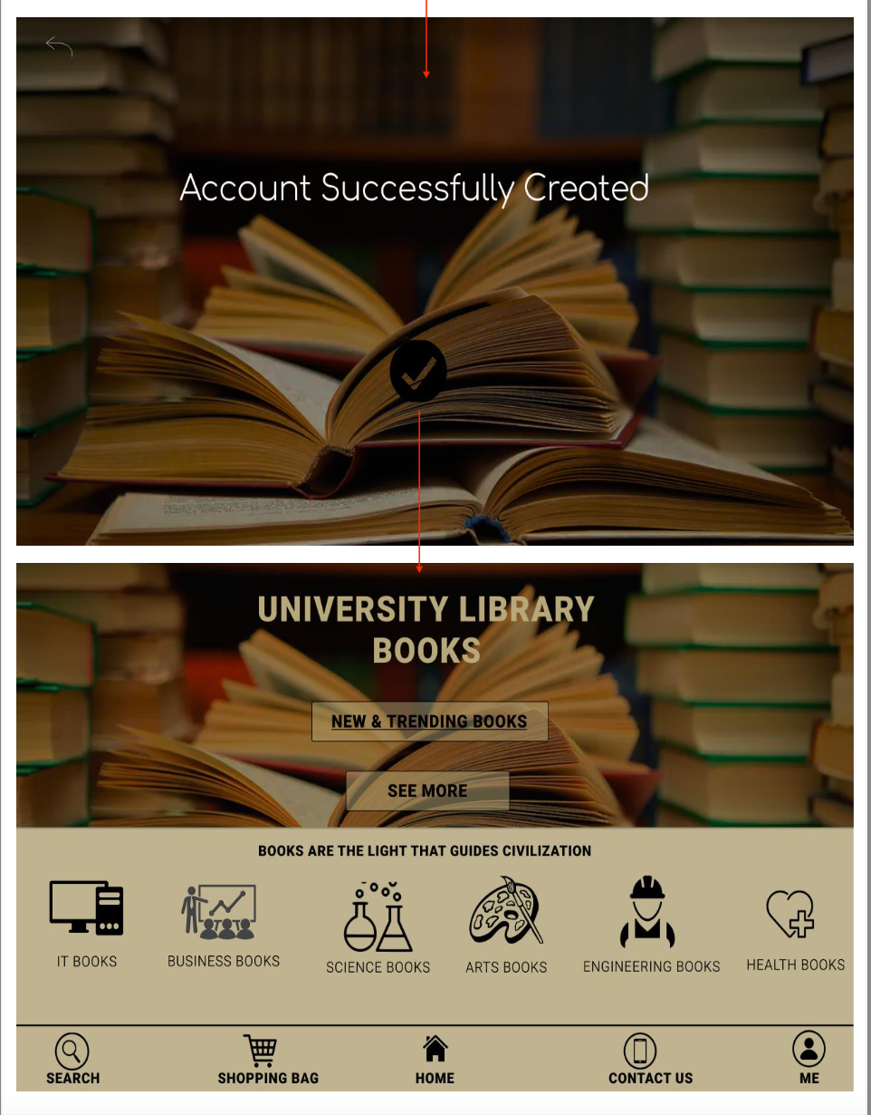
GUI Prototype

Slide 20



Methodologies
LUCID:
https://lucid.app/lucidchart/2db80a8a-cd95-453c-bb4e-0728be1a360b/edit?beaconFlowId=CAEA68F3D722F6E4&page=0_0&invitationId=inv_03a91f40-3f02-4797-98ba-6563b1f42b36#
FIGMA:
https://www.figma.com/files/recent?fuid=1106941211025968818

Slide 21


Conclusion:
Finally, our system can work on different platforms such as mobile, websites, or even an application on a computer. Therefore, our system focuses on helping students find their exciting books related to their major and help them get dependent resources that they can use in their studying journey. In addition, our system will create a share information process by rating activities or even suggesting that make students work together toward one goal.

Slide 22



Thank You

